Slide 1
OrderMaster
Denver Woolard, Harrison Aunspaw, Robert Sutton, Romel Miller, Lydia Clark

Slide 2
OrderMaster’s Goal
OrderMaster is a simple, intuitive program that allows owners and employees of a restaurant business to manage their orders. It also has functionality to manage servers or waiters, menu items, and tables.

Slide 3
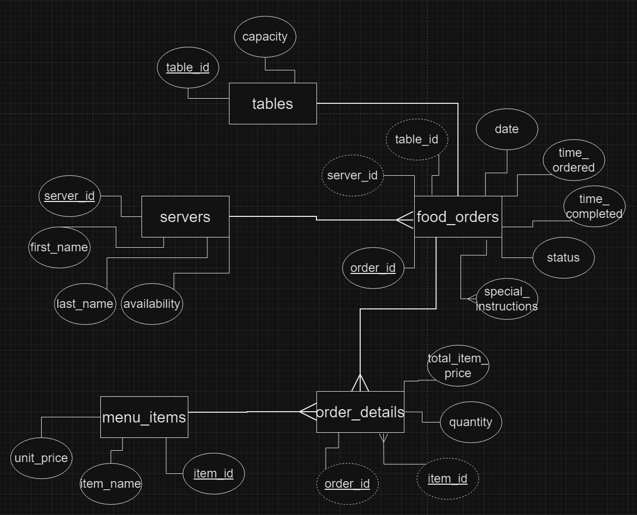

Slide 4
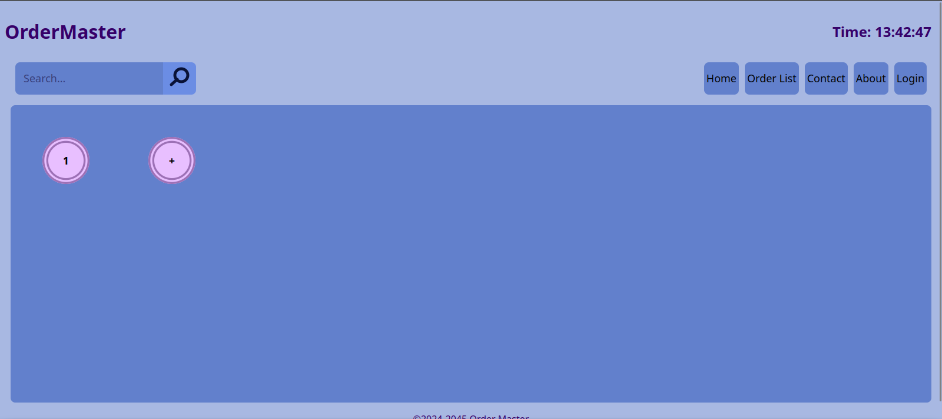
Homepage
Tables are represented here – the user can click on a table to go to its current active order

Slide 5
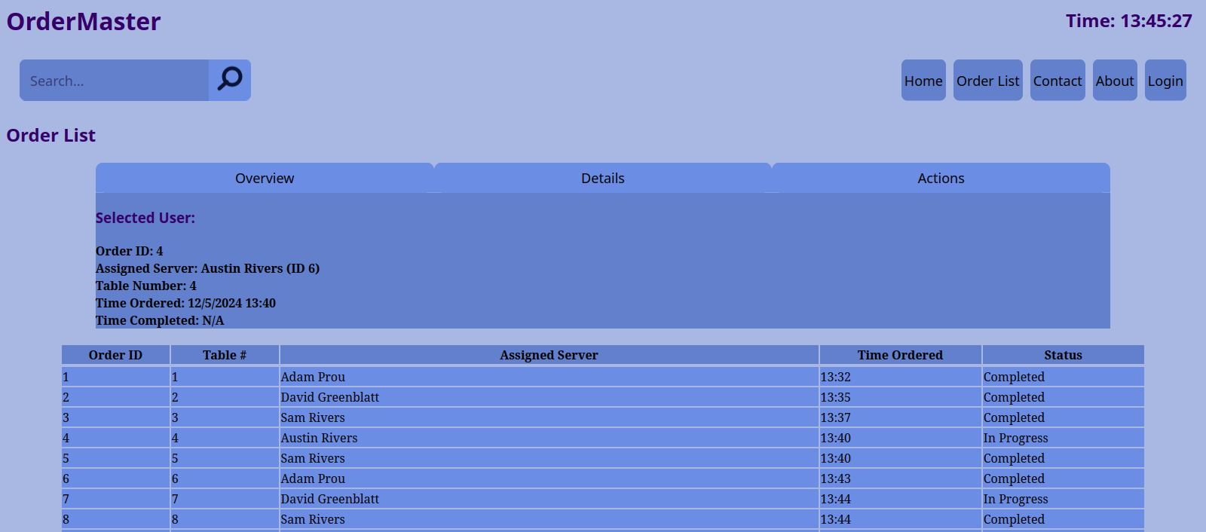
Order List
The main page that users will access. Allows control over registered orders.
Once an order is clicked, information can be viewed here. The tabs on the top allow navigation of different tiers of actions and information.
Orders are displayed in a brief table under the order details widget

